Slide 1

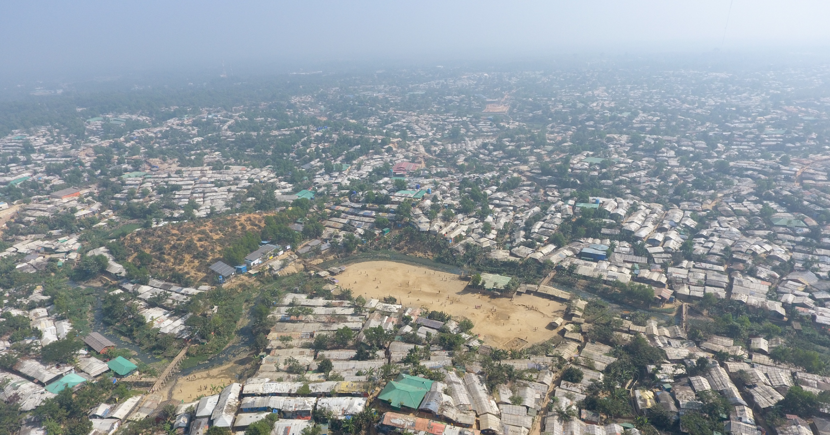

SCCCM Sector Coordination Meeting
Date: Monday, 31st of August 2026, 10:30 am
Venue: RCP Main Conference Room
Sector Website: https://rohingyaresponse.org/sectors/coxs-bazar/shelter-cccm/

Slide 2
Agenda
Opening & General Updates - Action points from last meeting
Funding Analysis for 2026
SMART Updates
CBI-NFI Approach
Road Traffic Accident (RTA)
  JRP 2027
  Awareness Campaign
  Initiative - Ongoing
  Challenges
Shelter Updates
  ESK Development Updates
  Harmonization of Mid-Term Shelter Activities
7. JRP 2027 Data Needs
  ISNA 2026
  Shelter Inventory Update
  SPSD - UNHCR to provide updates by 30 June 2026
8. Bhasan Char Challenges and Achievements
9. HLP Update
10. EEN Update
11. PSEA Update
12. Emergency Preparedness and Response (EPR) Update
  El Nino
  Weather Forecasting and Preparedness Measures
13. AoB

Slide 3
Action points from last meeting
Sl | Action Point | Lead / Status
1 | Share draft 2026-2027 Shelter Strategy for partner comments | Shelter WG / On going
2 | Funding Analysis for Q1 | SCCCM Sector / Completed
3 | Share draft MSSP strategy | MSSP WG / Completed
4 | Share updated/finalized ToRs for all working groups | SCCCM Sector / On going
5 | Convene Site Management WG meeting on SMART/site profiling tool, zoning and camp governance | SM WG / On going/ Piloting done
6 | Convene MSSP WG meeting on MESO/MICRO definitions and MSSP strategy | MSSP WG / Completed
7 | Convene technical discussion on double-story shelter designs for Camp 16 | Shelter Technical WG / Pending feedback from RRRC’s end
8 | Finalize and circulate HLP position paper on rental and due diligence | HLP WG / On going
9 | Continue recording and GIS mapping of HLP incidents, evictions and land disputes | Protection - IM / Ongoing
10 | Launch fire safety and fire-break restoration campaign | Shelter & Site Planning / Ongoing
11 | Organize joint WASH–Shelter–Protection–Health discussion on internal facilities and drainage risks | SCCCM Sector / Ongoing
12 | Consolidate and regularly update prepositioned NFI/shelter stock figures for contingency planning | SCCCM Sector / Ongoing
13 | Sector Annual Report 2025 | SCCCM Sector / Completed

Slide 4
Funding Updates

Slide 5


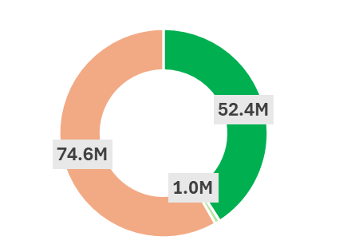
JRP 2026 Funding Analysis (as at 30 April)
SCCCM SECTOR
Major P1 + P2 Gaps & Pipeline Breaks
P1+P2 combined gap 65.4M: P2 activities are especially underfunded (only 15.5% funded).
Main pressure points: Shelter (24.6M gap), DRM (15.8M gap), NFI (11.2M gap), Access/Safety (7.6M gap).
Pipeline breaks: LPG likely breaks mid-Sept without $10.1M additional funding; NFI replenishment only 13.2% / 1.6M USD funded with available resources expected to cover needs only through Q2; post-hazard shelter support critically underfunded. Slope stabilization funding gap at 63.1% / 11.2M gap, posing significant challenges for completing critical works before and during the monsoon season.
Funding Required + Gap (CXB):
42% funded
58% gap
©WFP
128.0M
required
Other Gaps: P3 & R/S Critical Activities
P3 + R/S together 9.2M gap (R/S only 16.6% funded)
P3 has 2.1M gap while R/S has 7.1M gap can increase pressure on P1 activities. Additionally, underfunded nature-based risk reduction and watershed schemes hinder operational continuity, potentially leading to higher repair costs and greater service disruptions during the monsoon season.
Funding by priority
Impact of Greater Middle East Crisis
LPG price volatility is material: Cost of LPG refill increased by 29% since January while the refugee population grew by 2% from January to May. If prices remain around USD 18, a funding shortfall of 12M is anticipated by mid-September, necessitating additional support to meet needs through the end of the year.
Donor attention needed to avoid LPG interruption and protect life-saving shelter/NFI pipelines if regional pressure rises.
Key Messages: Consequences of Underfunding
Coordination & accountability at risk: Site management support is only 6.3% / 280K USD funded, weakening camp coordination, service-gap monitoring, site profiling, and timely cross-sector referrals. Without additional funding, the effectiveness of service delivery and support for vulnerable refugees will be further reduced.
Monsoon & hazard readiness at risk: The 11.2M gap (63%) in slope stabilization activities places at least 34,000 shelters and approximately 163,000 refugees at heightened risk from landslides and other environmental hazards within the camps. At the same time, refugees lack access to post-disaster shelter repair materials, while emergency non-food item (NFI) stocks remain critically low, with an 86.8% / 11.2M funding gap. Without immediate support, the ability to respond to and recover from hazard-related incidents will be severely constrained, increasing protection and shelter risks for affected populations.
Achievements
Reached/achieved
Refugee households reached with Shelter assistance * Partners has recently signed partnership agreement, and activities have commenced, with achievements to be reported in the upcoming exercise.
Refugee households received NFI
Slope Stabilization (43,208 sq-m completed against a target of 427,212 sq m) *WFP and FAO will start slope stabilization activities during this monsoon season.
5

Slide 6
SMART Updates

Slide 7
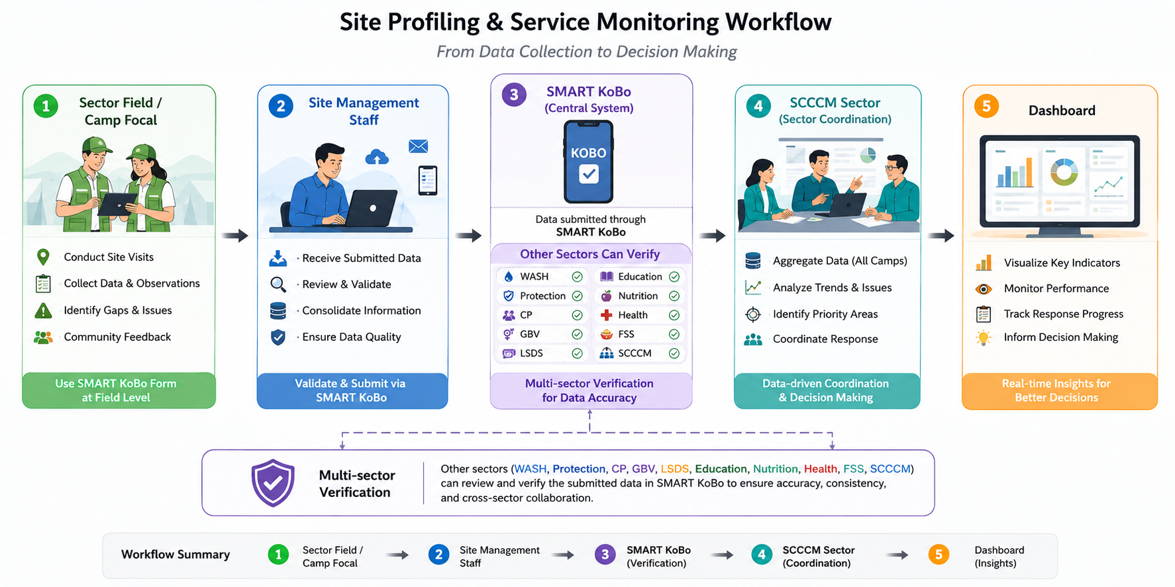
SMAMT UPDATE

Slide 8
CBI-NFI Updates

Slide 9
with
CONCEPT NOTE · v. June 2026
Purpose
Cross-Sector NFI Mapping & Delivery Options
A time-bound exercise to assess whether selected household NFI assistance can be delivered more efficiently, consistently and locally — through in-kind, voucher or mixed cash/voucher modalities — to inform practical decisions for JRP 2027.
In-kind · Voucher · Cash-Based Modalities
Why now
Funding constraints & reduced operational space — SCCCM NFI in JRP 2026 ≈ USD 12.9M (down from ~USD 35M in 2024).
An existing monthly stock & distribution monitoring system across 13 active NFI partners provides a ready basis to expand mapping cross-sector.
Localization treated as a core lens — where goods/services can be produced, repaired, distributed or monitored via local/national partners and refugee-linked initiatives.
No assumption that cash or vouchers are always cheaper — UN tax exemptions & bulk procurement can favour in-kind for some items.
LEAD
RCP support by SCCCM
SCOPE
Household NFIs only — a focused test case, not a response-wide CBI strategy
ENDORSEMENT
By end-July 2026 → feeds ISNA (Aug) & JRP 2027 (Sep)
1

Slide 10
Scope & Analytical Workstreams
NFIs distributed by SCCCM Sector and other sectors — WASH, GBV, Protection, Livelihoods and relevant agency programmes
IN SCOPE — CURRENT NFI BASKET & CANDIDATES
Blankets
Sleeping mats
Mosquito nets
Solar lights
Kitchen sets
WASH & hygiene NFIs
Dignity items
Fishing nets
Repair materials
Reusable packaging
Solar-lamp repair
TRACK 1
TRACK 2
Cross-Sector NFI Mapping & Data Compilation
Delivery Options, Market Analysis & Cost Comparison
SCCCM adapts its monthly monitoring template for use across sectors; partners share existing data.
Against the catalogue, partners assess in-kind, voucher and mixed cash/voucher feasibility.
Items, target groups & coverage
Stock, distributions, pipeline & contingency
Unit costs, suppliers & procurement
Warehousing, transport & distribution
Existing & potential localization elements
Market availability & vendor density
platform & logistics costs
Price volatility, tax & procurement
Protection, dignity, choice & accountability
Diversion, exclusion & market-distortion risks
Output → a consolidated cross-sector NFI catalogue & baseline of current delivery.
WFP, UNICEF, UNFPA, BRAC & others contribute platform inputs & lessons learned.
Cross-Sector NFI Mapping & Delivery Options · Concept Note v.170626
2

Slide 11
Constraints, Outputs & Next Steps
Key Constraints & Assumptions
Expected Outputs
Recommended Next Steps
Full cash delivery unlikely short-term — policy, documentation & movement restrictions.
Refugees cannot open formal bank accounts; SIM registration & data ownership unresolved.
Financial inclusion sandbox (MoDMR, WFP, UNHCR, IFRC, World Bank) implementing in 2026; findings early 2027.
6,000+ SIM cards distributed by RRRC/UNHCR in Camp 4 & 4 Ext — still registered to RRRC pending UNHCR–Government agreement.
Vouchers / mixed cash-voucher more realistic than unrestricted cash in the short to medium term.
1. Consolidated cross-sector NFI catalogue
2. Summary of current modalities, costs & arrangements
3. Preliminary market & feasibility analysis
4. Costed options: in-kind vs voucher vs mixed
5. Localization analysis (local/national NGOs, suppliers, community & refugee-linked roles)
6. Reflection in the Transformation Tracker if a more efficient modality is viable
7. Recommendations for JRP 2027 — pilots & policy/government engagement
Circulate this concept note for review by Shelter/CCCM, RCP & sector focal points.
Once agreed, Shelter/CCCM convenes a short consultation — confirm participation & request NFI data via the adapted template.
A technical group consolidates data, prepares delivery options & develops recommendations by end-July.
In parallel, RCP considers a time-bound CBI Working Group — linked to, but distinct from, this NFI exercise.
Jun–Jul 2026
End-July 2026
August 2026
From Sep 2026
Review & endorse
Recommendations ready
Inform ISNA analysis
JRP 2027 planning
Cross-Sector NFI Mapping & Delivery Options · Concept Note v.170626
3

Slide 12
Shelter Updates
Emergency Shade Kit (ref. IOM kit)
Emergency Shelter Kit (ESK) Development Updates
Harmonization of Mid-Term Shelter (MTS) Activities
Temporary Safer Shelter (TSS)
  Shelter Repair Kit

